Slide 1


MEDICATION ADVISORY SYSTEM USING MACHINE LEARNING
Presentation by Janhavi Shedge (570)

Slide 2

TABLE OF CONTENT
01. INTRODUCTION
02. PROBLEM STATEMENT
03. ADVANTAGES
04. FUTURE SCOPE
06. CONCLUSION

Slide 3

INTRODUCTION
Project creates a disease prediction system that analyzes user symptoms to forecast potential health conditions.
Utilizes a trained model on a comprehensive dataset of diseases and symptoms to deliver accurate predictions.
Offers personalized suggestions for medications, precautions, and lifestyle changes based on predictions.
Aims to reduce immediate medical consultations by providing early diagnostic insights.
Applications: Enhances telemedicine, online health diagnosis, and patient education by improving access to health information.

Slide 4
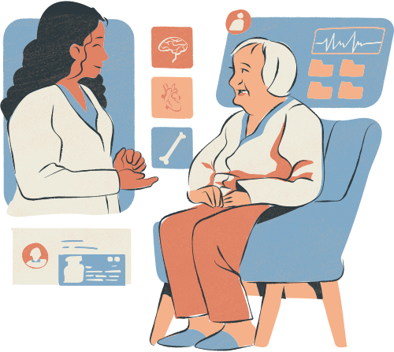
PROBLEM STATEMENT
Medical diagnosis can be time-consuming and inaccessible for many, especially in remote areas.
There is a lack of quick, preliminary diagnostic tools for common symptoms, which delays early detection and treatment.
Healthcare systems are often overburdened, leading to longer waiting times for consultations and diagnosis.
Many people lack awareness about potential health issues due to ignoring early symptoms.
The cost of regular medical consultations can be high, particularly for minor concerns.
There is a need for an efficient, accessible, and cost-effective system that predicts diseases based on symptoms.

Slide 5

ADVANTAGES
Rapid Diagnosis: Provides instant disease predictions, enabling users to take timely preventive or corrective actions.
Remote Healthcare Access: Offers health services to users in remote or rural areas with limited access to healthcare facilities.
Cost Efficiency: Reduces the need for frequent medical visits, saving on consultation fees and travel costs.
Early Detection: Identifies potential diseases at an early stage, which can lead to better management and treatment outcomes.
User Empowerment: Encourages users to take control of their health by providing them with information based on their symptoms.
Scalability: The system can be easily scaled to handle large amounts of data and users, providing widespread access.

Slide 6

FUTURE SCOPE
The system can be improved by incorporating a larger dataset covering more diseases, symptoms, and patient demographics.
Adding support for real-time health monitoring devices (such as smartwatches) to enhance prediction accuracy.
Introducing personalized predictions by considering users' medical histories, age, and genetic predispositions.
Expanding the system’s reach by offering support for multiple languages and region-specific diseases.
Deploying the system as a mobile app for greater accessibility, allowing users to receive predictions on the go.
Partnering with hospitals and clinics to validate and refine the model for use in professional settings.

Slide 7
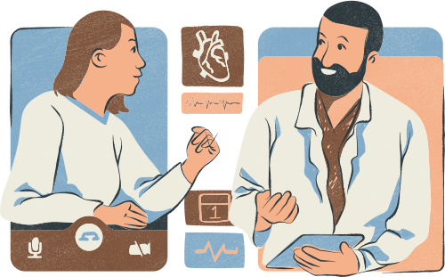
CONCLUSION
The symptom-based disease prediction system provides a fast and accessible way for users to receive preliminary health insights based on their symptoms. By leveraging machine learning models, it offers valuable information on potential diseases and suggests medications, precautions, and lifestyle changes. While the system presents a promising solution to reduce diagnostic delays and increase accessibility, it should complement, not replace, professional medical consultations. With further advancements, such as larger datasets, personalization, and enhanced accuracy, this technology can become a powerful tool in preventive healthcare and remote diagnosis.

Slide 8





